Slide 1
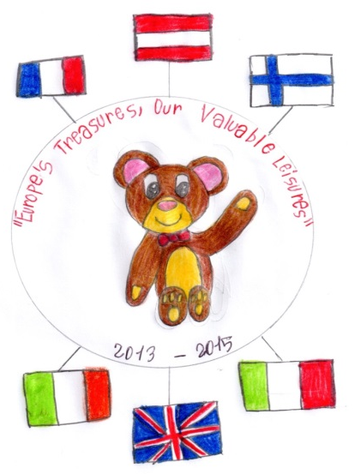
Europe’s Treasure – our Valuable Leisure
A European project with schools from Austria, England, Finland, France, Ireland and Italy.
Notes:
[[[[[[[[[[[[[[[[[[[[[[[[[[[[[[[[[[[[[[[[[[[[[[[[[[[[[[[[[[[[[[[[[[[[[[[[[[[[[[[[[[[[[[[[[[[[[[[[[[[[[[[[[[[[[[[[[[[[[[[[[[[[[[[[[[[[[[[[[[[[[[[[[[[[[[[[[[[[[[[[[[[[[[[[[[[[[[[[[[[[[[[[[[[[[[[[[[[[[[[[[[[[[[[[[[[[[[[[[[[[[[[[[[[[[[[[[[[[[[[[[[[[[[[[[[[[[[[[[[[[[[[[[[[[[[[[[[[[[[[[[[[[[[[[[[[[[[[[[[[[[[[[[[[[[[[[[[[[[[[[[[[[[[[[[[[[[[[[[[[[[[[[[[[[[[[[[[[[[[[[[[[[[[[[[[[[[[[[[[[[[[[[[[[[[[[[[[[[[[[[[[[[[[[[[[[[[[[[[[[[[[[[[[[[[[[[[[[[[[[[[[[[[[[[[[[[[[[[[[[[[[[[[[[[[[[[[[[[[[[[[[[[[[[[[[[[[[[[[[[[[[[[[[[[[[[[[[[[[[[[[[[[[[[[[[[[[[[[[[[[[[[[[[[[[[[[[[[[[[[[[[[[[[[[[[[[[[[[[[[[[[[[[[[[[[[[[[[[[[[[[[[[[[[[[[[[[[[[[[[[[[[[[[[[[[[[[[[[[[[[[[[[[[[[[[[[[[[[[[[[[[[[[[[[[[[[[[[[[[[[[[[[[[[[[[[[[[[[[[[[[[[[[[[[[[[[[[[[[[[[[[[[[[[[[[[[[[[[[[[[[[[[[[[[[[[[[[[[[[[[[[[[[[[[[[[[[[[[[[[[[[[[[[[[[[[[[[[[[[[[[[[[[[[[[[[[[[[[[[[[[[[[[[[[[[[[[[[[[[[[[[[[[[[[[[[[[[[[[[[[[[[[[[[[[[[[[[[[[[[[[[[[[[[[[[[[[[[[[[[[[[[[[[[[[[[[[[[[[[[[[[[[[[[[[[[[[[[[[[[[[[[[[[[[[[[[[[[[[[[[[[[[[[[[[[[[[[[[[[[[[[[[[[[[[[[[[[[[[[[[[[[[[[[[[[[[[[[[[[[[[[[[[[[[[[[[[[[[[[[[[[[[[[[[[[[[[[[[[[[[[[[[[[[[[[[[[[[[[[[[[[[[[[[[[[[[[[[[[[[[[[[[[[[[[[[[[[[[[[[[[[[[[[[[[[[[[[[[[[[[[[[[[[[[[[[[[[[[[[[[[[[[[[[[[[[[[[[[[[[[[[[[[[[[[[[[[[[[[[[[[[[[[[[[[[[[[[[[[[[[[[[[[[[[[[[[[[[[[[[[[[[[[[[[[[[[[[[[[[[[[[[[[[[[[[[[[[[[[[[[[[[[[[[[[[[[[[[[[[[[[[[[[[[[[[[[[[[[[[[[[[[[[[[[[[[[[[[[[[[[[[[[[[[[[[[[[[[[[[[[[[[[[[[[[[[[[[[[[[[[[[[[[[[[[[[[[[[[[[[[[[[[[[[[[[[[[[[[[[[[[[[[[[[[[[[[[[[[[[[[[[[[[[[[[[[[[[[[[[[[[[[[[[[[[[[[[[[[[[[[[[[[[[[[[[[[[[[[[[[[[[[[[[[[[[[[[[[[[[[[[[[[[[[[[[[[[[[[[[[[[[[[[[[[[[[[[[[[[[[[[[[[[[[[[[[[[[[[[[[[[[[[[[[[[[[[[[[[[[[[[[[[[[[[[[[[[[[[[[[[[[[[[[[[[[[[[[[[[[[[[[[[[[[[[[[[[[[[[[[[[[[[[[[[[[[[[[[[[[[[[[[[[[[[[[[[[[[[[[[[[[[[[[[[[[[[[[[[[[[[[[[[[[[[[[[[[[[[[[[[[[[[[[[[[[[[[[[[[[[[[[[[[[[[[[[[[[[[[[[[[[[[[[[[[[[[[[[[[[[[[[[[[[[[[[[[[[[[[[[[[[[[[[[[[[[[[[[[[[[[[[[[[[[[[[[[[[[[[[[[[[[[[[[[[[[[[[[[[[[[[[[[[[[[[[[[[[[[[[[[[[[[[[[[[[[[[[[[[[[[[[[[[[[[[[[[[[[[[[[[[[[[[[[[[[[[[[[[[[[[[[[[[[[[[[[[[[[[[[[[[[[[[[[[[[[[[[[[[[[[[[[[[[[[[[[[[[[[[[[[[[[[[[[[[[[[[[[[[[[[[[[[[[[[[[[[[[[[[[[[[[[[[[[[[[[[[[[[[[[[[[[[[[[[[[[[[[[[[[[[[[[[[[[[[[[[[[[[[[[[[[[[[[[[[[[[[[[[[[[[[[[[[[[[[[[[[[[[[[[[[[[[[[[[[[[[[[[[[[[[[[[[[[[[[[[[[[[[[[[[[[[[[[[[[[[[[[[[[[[[[[[[[[[[[[[[[[[[[[[[[[[[[[[[[[[[[[[[[[[[[[[[[[[[[[[[[[[[[[[[[[[[[[[[[[[[[[[[[[[[[[[[[[[[[[[[[[[[[[[[[[[[[[[[[[[[[[[[[[[[[[[[[[[[[[[[[[[[[[[[[[[[[[[[[[[[[[[[[[[[[[[[[[[[[[[[[[[[[[[[[[[[[[[[[[[[[[[[[[[[[[[[[[[[[[[[[[[[[[[[[[[[[[[[[[[[[[[[[[[[[[[[[[[[[[[[[[[[[[[[[[[[[[[[[[[[[[[[[[[[[[[[[[[[[[[[[[[[[[[[[[[[[[[[[[[[[[[[[[[[[[[[[[[[[[[[[[[[[[[[[[[[[[[[[[[[[[[[[[[[[[[[[[[[[[[[[[[[[[[[[[[[[[[[[[[[[[[[[[[[[[[[[[[[[[[[[[[[[[[[[[[[[[[[[[[[[[[[[[[[[[[[[[[[[[[[[[[[[[[[[[[[[[[[[[[[[[[[[[[[[[[[[[[[[[[[[[[[[[[[[[[[[[[[[[[[[[[[[[[[[[[[[[[[[[[[[[[[[[[[[[[[[[[[[[[[[[[[[[[[[[[[[[[[[[[[[[[[[[[[[[[[[[[[[[[[[[[[[[[[[[[[[[[[[[[[[[[[[[[[[[[[[[[[[[[[[[[[[[[[[[[[[[[[[[[[[[[[[[[[[[[[[[[[[[[[[[[[[[[[[[[[[[[[[[[[[[[[[[[[[[[[[[[[[[[[[[[[[[[[[[[[[[[[[[[[[[[[[[[[[[[[[[[[[[[[[[[[[[[[[[[[[[[[[[[[[[[[[[[[[[[[[[[[[[[[[[[[[[[[[[[[[[[[[[[[[[[[[[[[[[[[[[[[[[[[[[[[[[[[[[[[[[[[[[[[[[[[[[[[[[[[[[[[[[[[[[[[[[[[[[[[[[[[[[[[[[[[[[[[[[[[[[[[[[[[[[[[[[[[[[[[[[[[[[[[[[[[[[[[[[[[[[[[[[[[[[[[[[[[[[[[[[[[[[[[[[[[[[[[[[[[[[[[[[[[[[[[[[[[[[[[[[[[[[[[[[[[[[[[[[[[[[[[[[[[[[[[[[[[[[[[[[[[[[[[[[[[[[[[[[[[[[[[[[[[[[[[[[[[[[[[[[[[[[[[[[[[[[[[[[[[[[[[[[[[[[[[[[[[[[[[[[[[[[[[[[[[[[[[[[[[[[[[[[[[[[[[[[[[[[[[[[[[[[[[[[[[[[[[[[[[[[[[[[[[[[[[[[[[[[[[[[[[[[[[[[[[[[[[[[[[[[[[[[[[[[[[[[[[[[[[[[[[[[[[[[[[[[[[[[[[[[[[[[[[[[[[[[[[[[[[[[[[[[[[[[[[[[[[[[[[[[[[[[[[[[[[[[[[[[[[[[[[[[[[[[[[[[[[[[[[[[[[[[[[[[[[[[[[[[[[

Slide 2
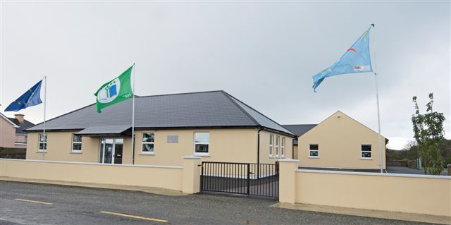
Knockskeagh National School, Clonakilty, Ireland
www.knockskeaghns.ie

Slide 3
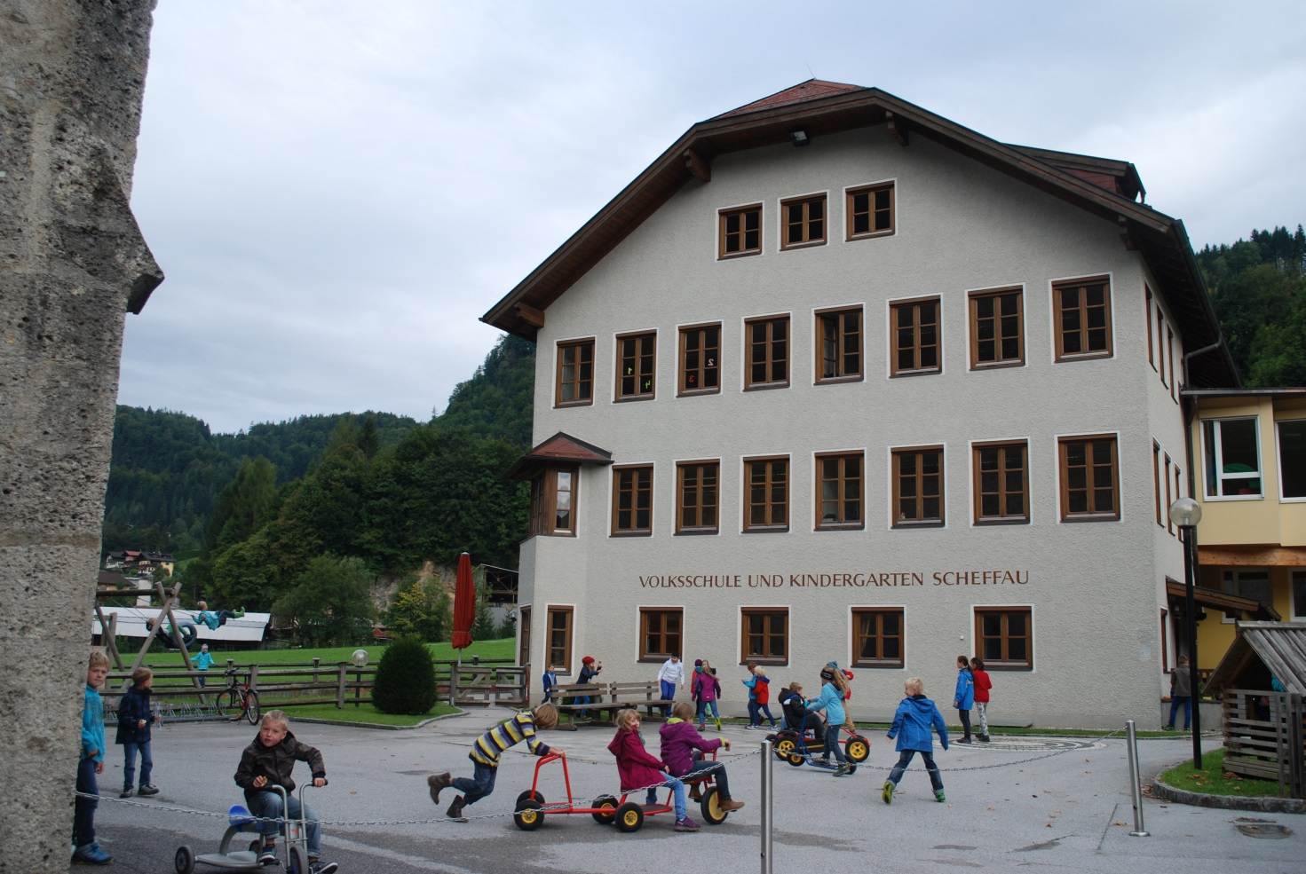
Volksschule Scheffau, Austria
www.vs-scheffau.at

Slide 4
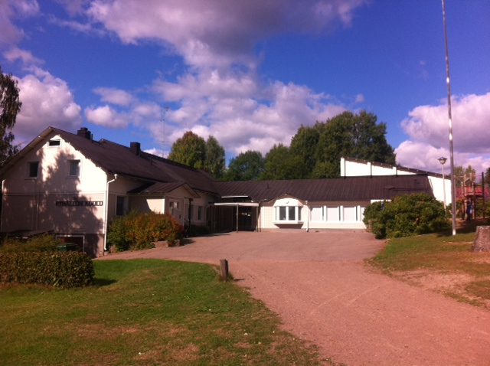
Pyhältö school, Finland
www.hamina.fi/fi/asukkaat/koulutus
ja opetus/peruskoulut/pyhällönkoulu

Slide 5
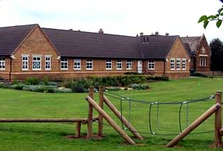
Gamlingay First School, England
www.gamlingayfirst.com

Slide 6
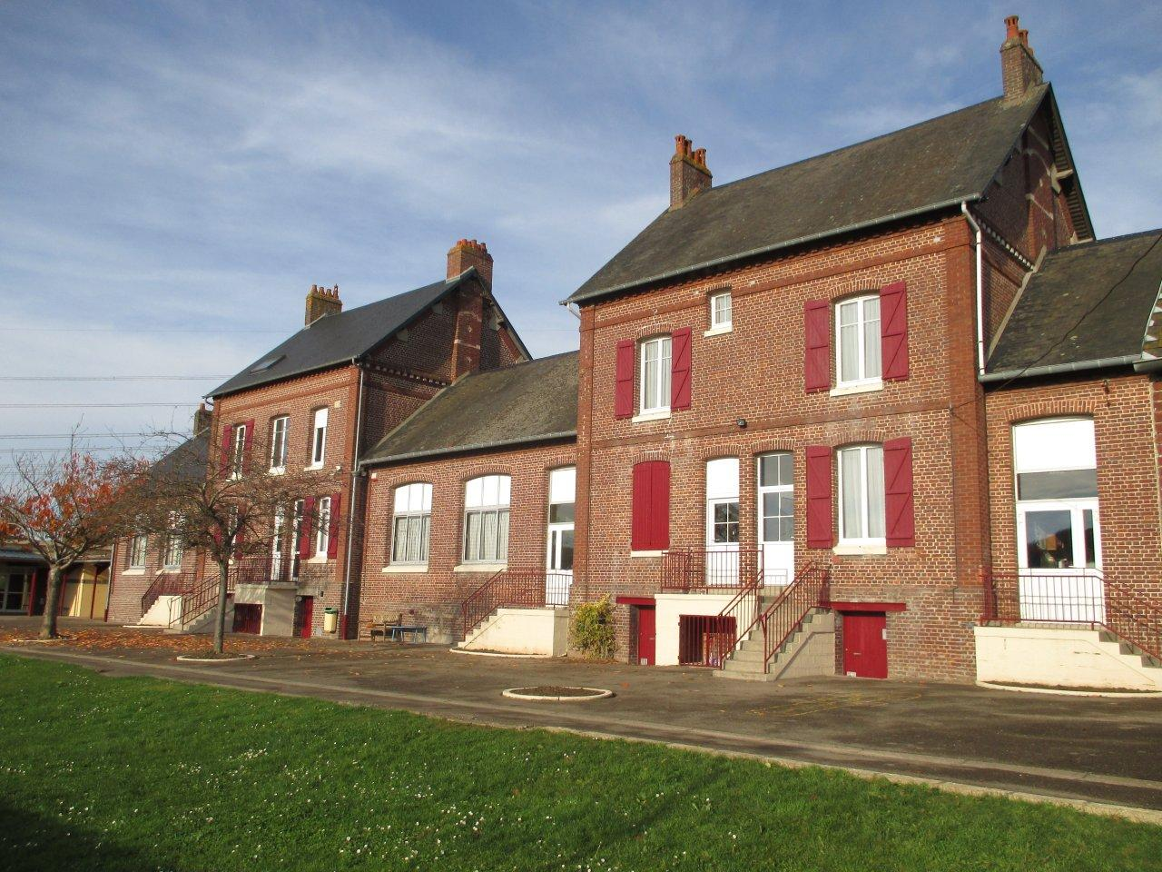
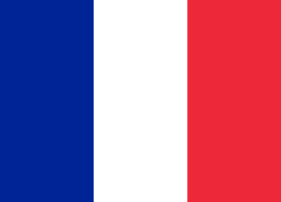
Ecole Primaire d’Oust – Marest
http://oust-marest.ee.ac-amiens.fr

Slide 7
I.C.S ‘Lombardo Radice’ Italy
www.comprensivolombardoradice.it

Slide 8
Austria, October 2013
Our first meeting was hosted by Volksschule Scheffau.
At the meeting there were 2 English, one Finnish, 4 French, 3 Irish, and 3 Italian representatives.

Slide 9
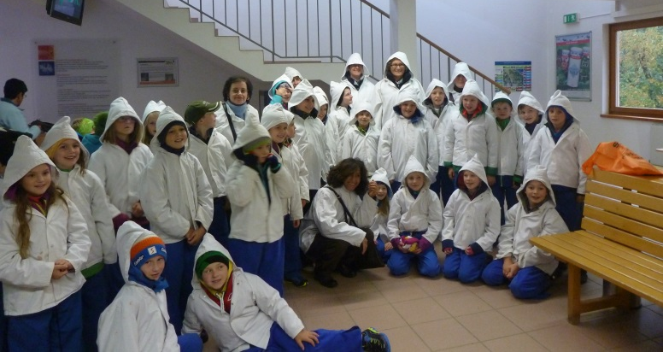
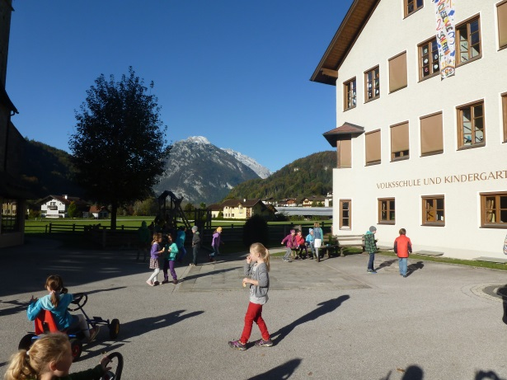
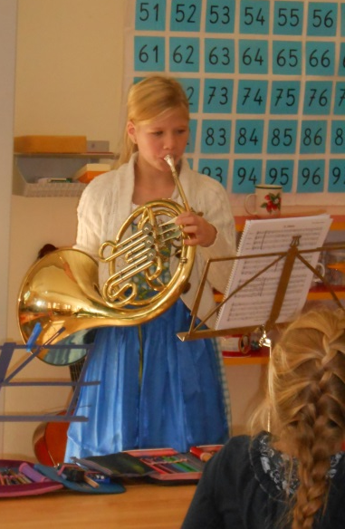

Slide 10
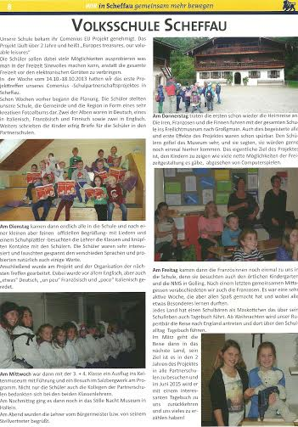
Our visit to Scheffau made it into the local papers!

Slide 11
Logos
Each school submitted one logo for the project.

Slide 12
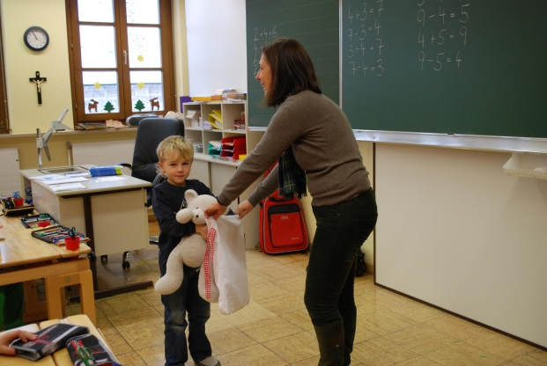
Our Project Logo
The logo was chosen at random from the 6 entries by an Austrian child. The winning logo was designed by an Italian pupil.

Slide 13
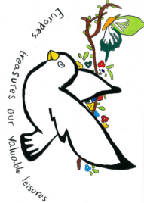
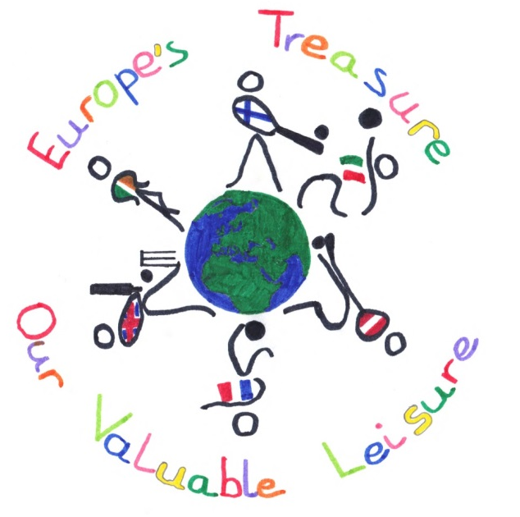
English Entry
Finnish Entry
Austrian Entry
Irish Entry
French Entry

Slide 14
Surveys Autumn 2013
Each school carried out a questionnaire to see how children spent their leisure time.

Slide 20
Travelling Bears
Each school had a bear who visited all the other schools over the 2 year project, before returning home and sharing about their travels!

Slide 21
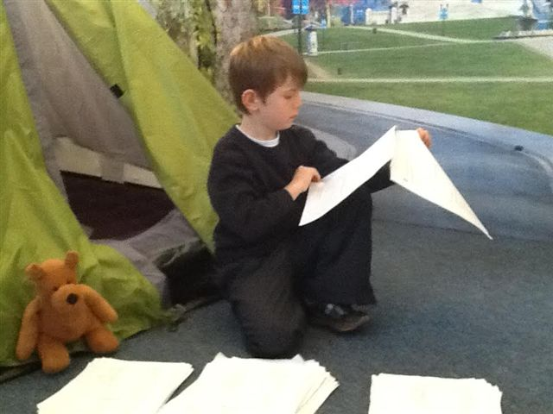
Paddy the Irish Bear helped with the Comenius survey

Slide 22
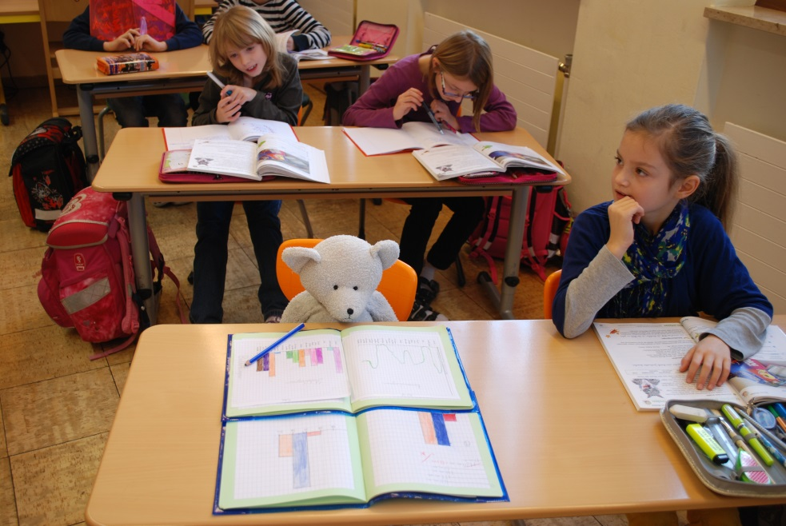
Rupert the Austrian Bear visited England to find out how English children spend their leisure time.

Slide 23
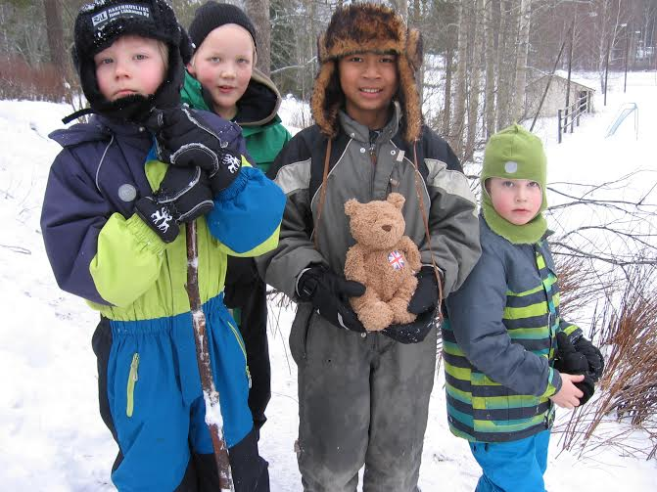
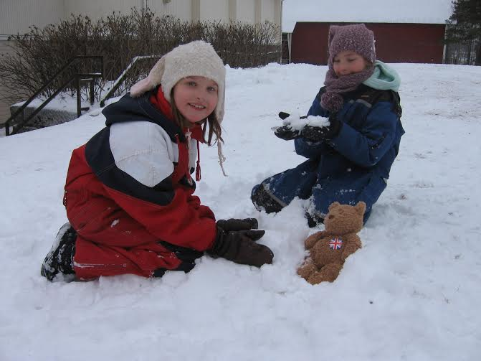
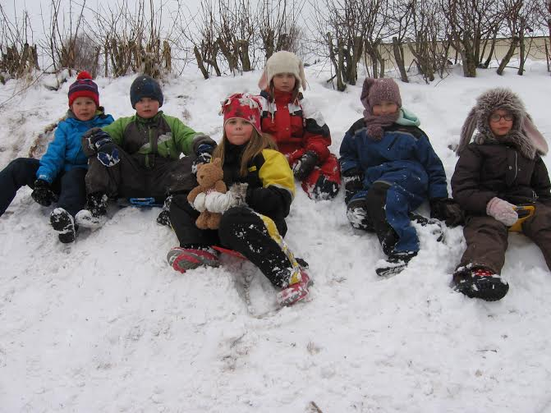
Barty, the English Bear, played in the snow on his visit to Finland

Slide 24
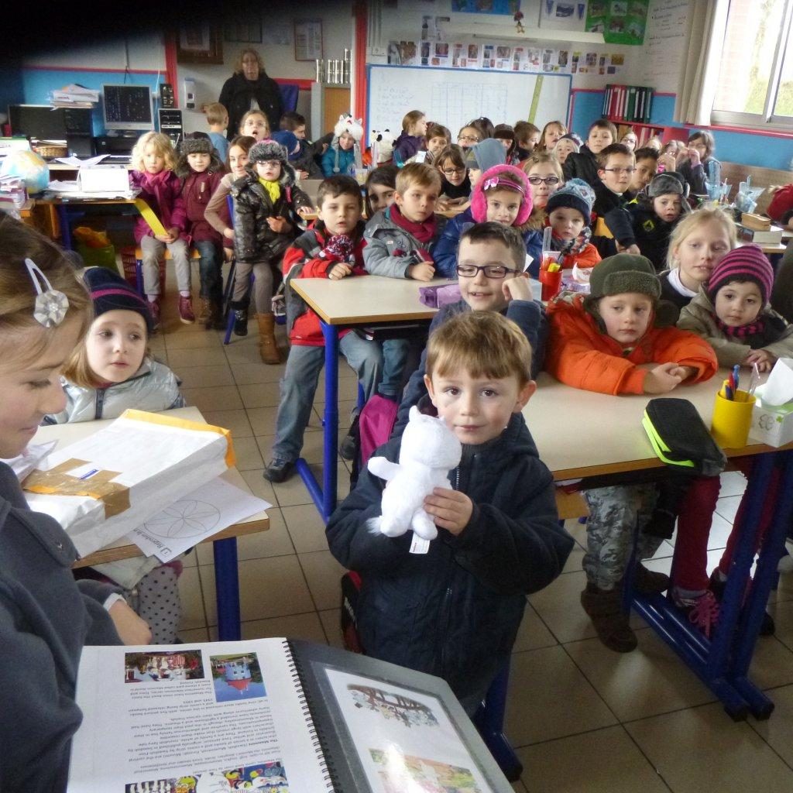
The Finnish Bear, Moomin, visited France to find out about their hobbies.

Slide 25
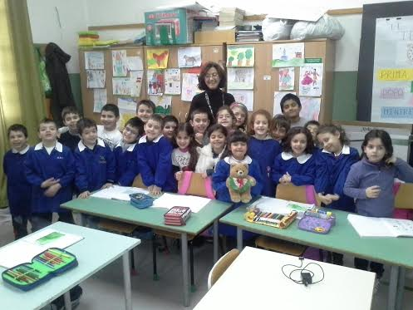
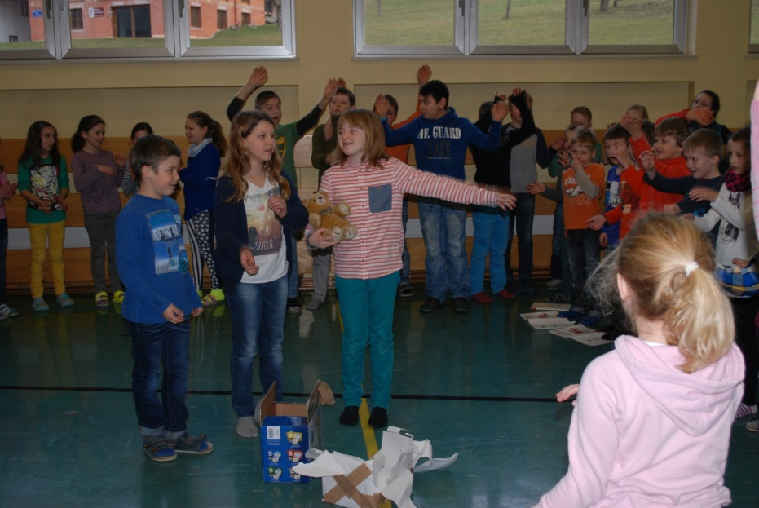
The Italian Bear Bruno…
…was warmly welcomed by children in Austria

Slide 26
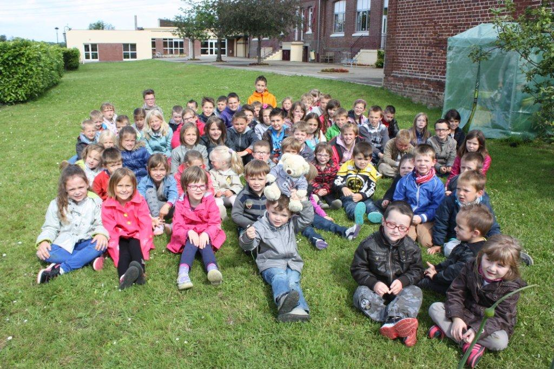
Saffie, the French bear, before he headed off on his travels!

Slide 27
Focus: traditions and customs - Christmas
Each school shared with others about how they celebrate Christmas

Slide 28
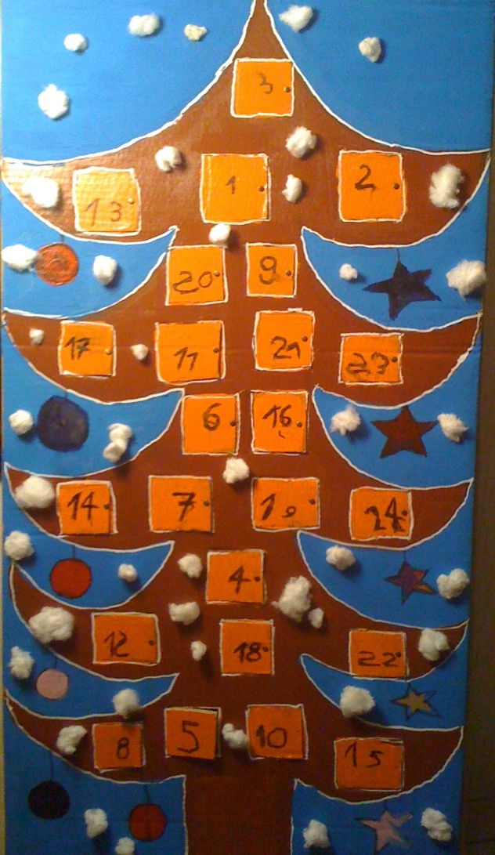
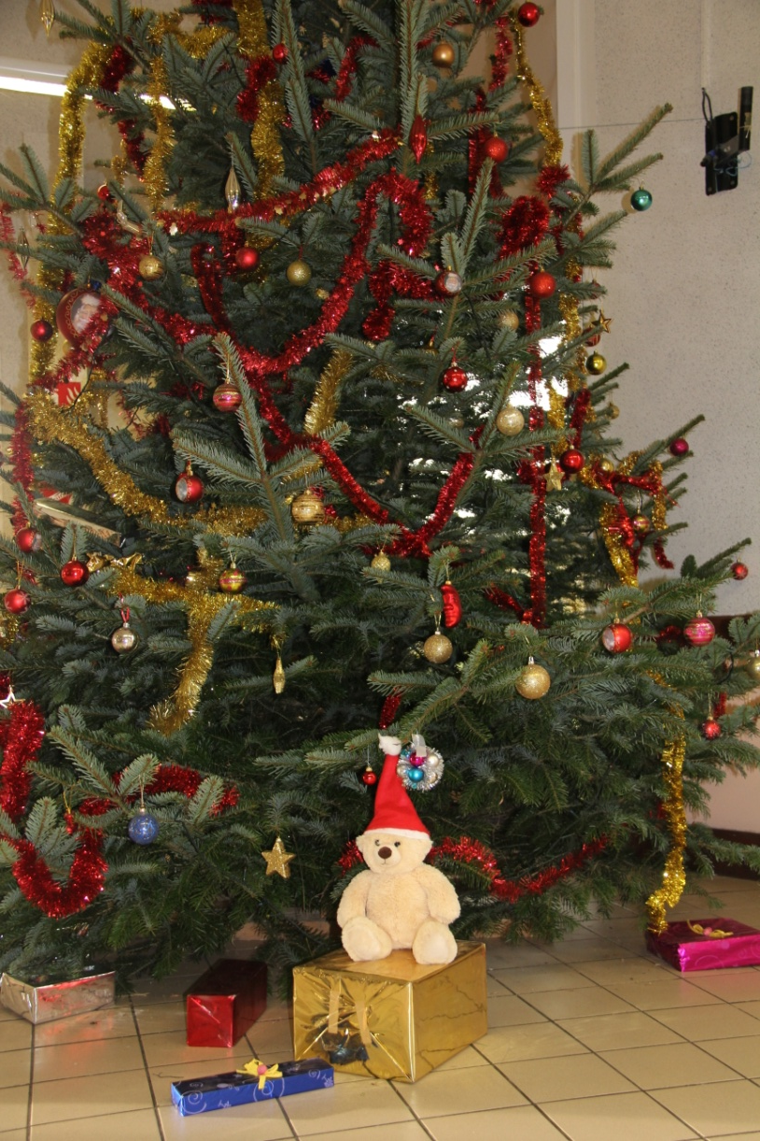
Christmas in Oust-Marest
Most pupils have a special calendar:
every day they open a little window and find a chocolate (or a small present) inside.
We decorate our houses, inside and outside and we decorate our Christmas trees.

Slide 29
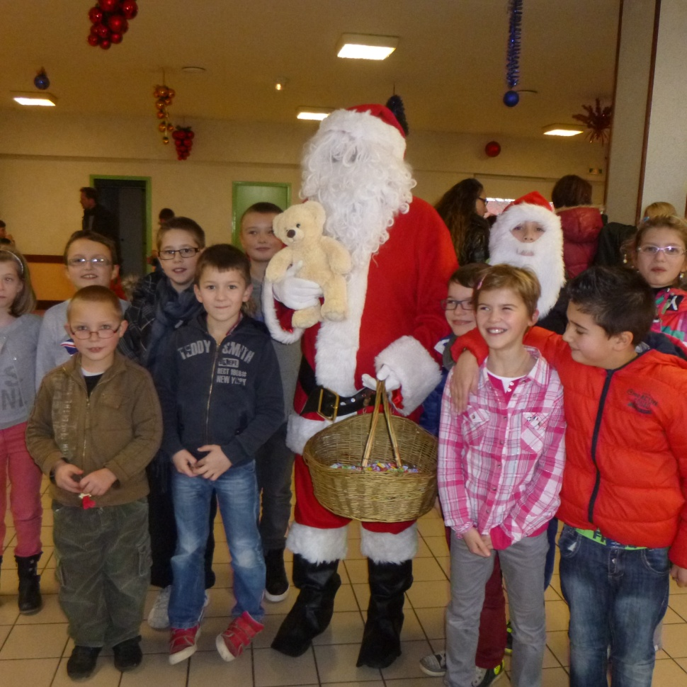
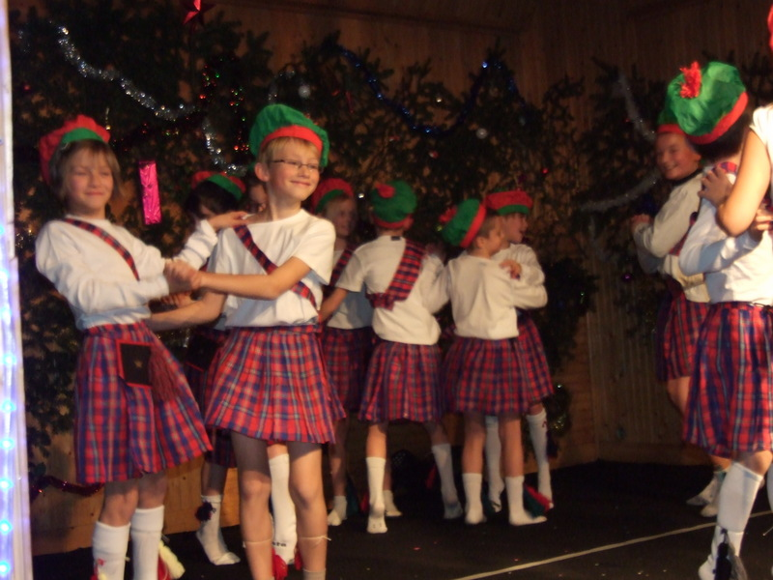
Our children are all waiting for Father Christmas to come. It’s quite easy to meet him in towns, shops...
We have a festival at school: parents are invited and pupils show their dances, songs, plays ...
At the end of the day, Father Christmas comes and offers
a present to every child.

Slide 30
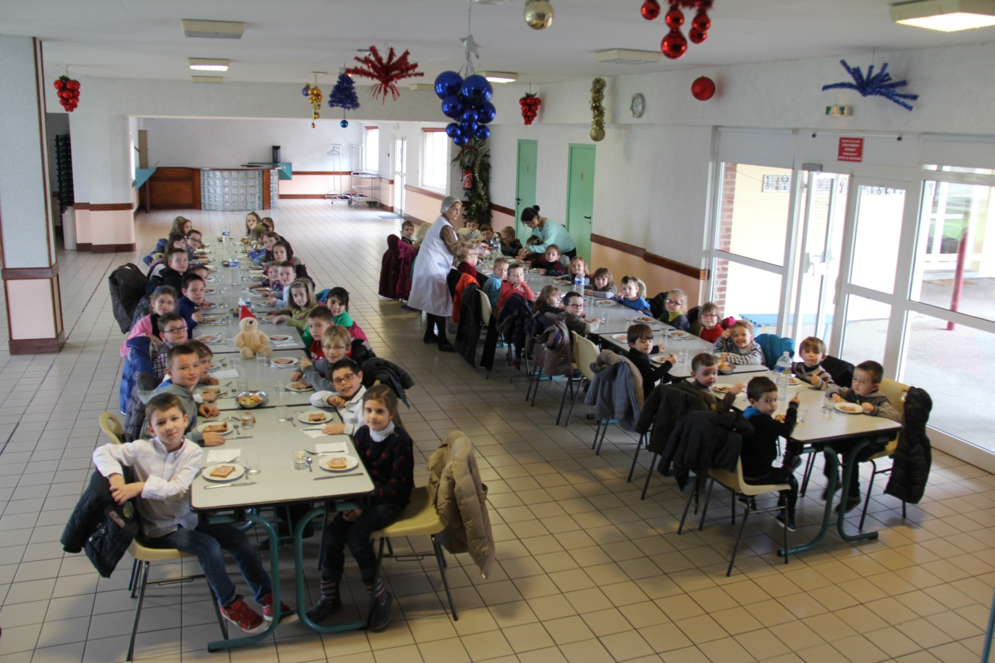
We have a Christmas
meal at school…
We start to celebrate Christmas on 24th December. It’s called le réveillon.
Pupils put their shoes in front of the chimney or at the bottom of the Christmas tree before going to bed. Sometimes they leave milk and biscuits for Father Christmas.

Slide 31
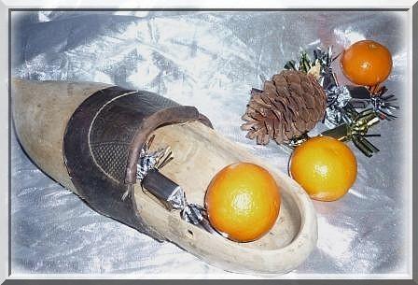
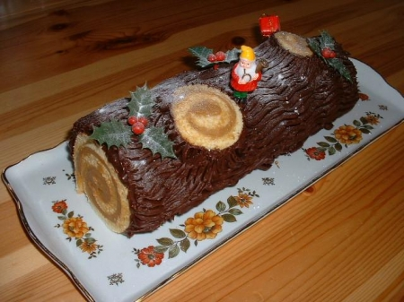
On 25th December, children find their presents in their shoes. In the past it used to be only an orange. Nowadays it’s often much more!
Adults exchange presents too.
Families share a special meal:
Smoked salmon / Foie gras
Turkey with chestnuts
Bûche de Noël
– it’s a special cake that looks
like a log

Slide 32
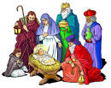
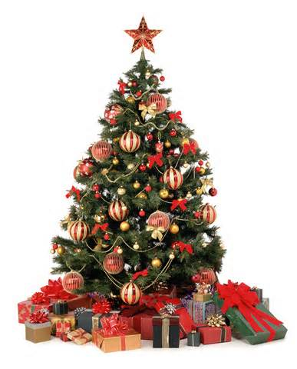
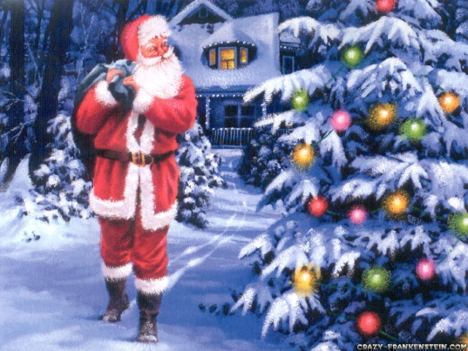
Irish Christmas Customs
Santa Claus brings presents on Christmas Eve. He usually comes down the chimney and travels from the North Pole in a flying sleigh pulled by reindeer!
We decorate our homes and school with cribs and Christmas trees.
We light a Christmas candle to show Mary and Joseph on the way to Bethlehem

Slide 33
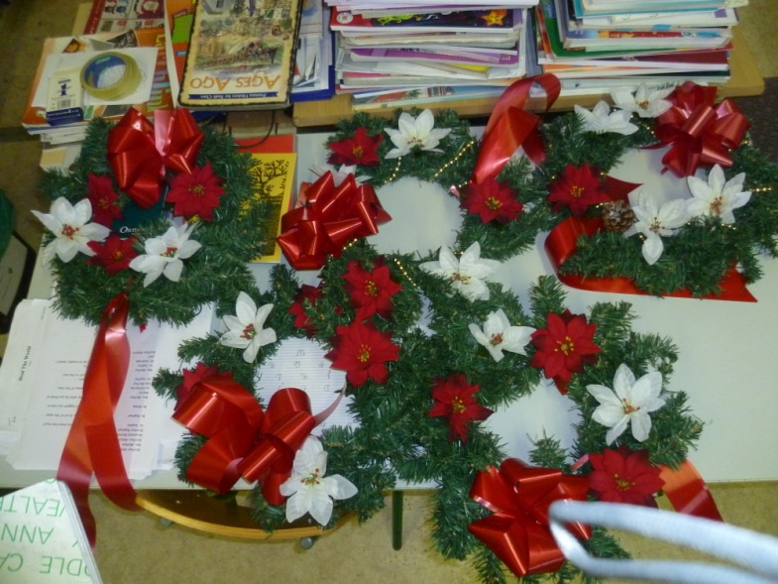
We make Christmas wreaths

Slide 34
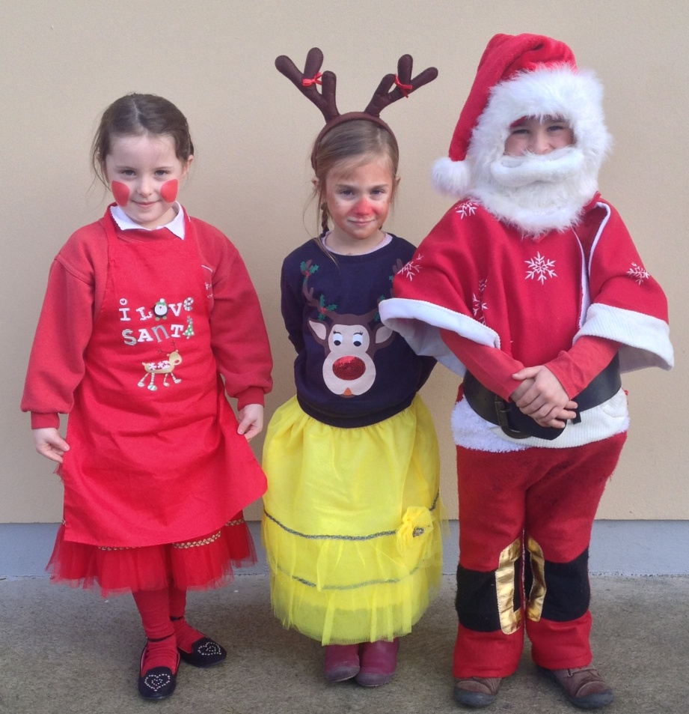
We put on a Christmas play in school

Slide 35
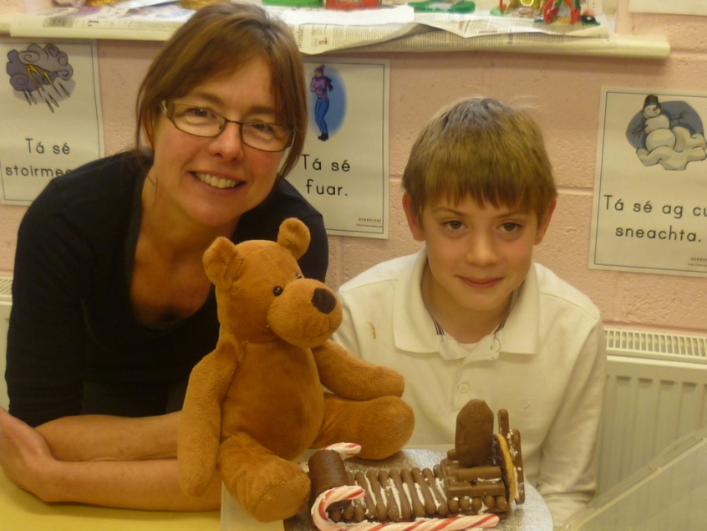
We eat special food at Christmas. In school we make chocolate sleighs.

Slide 36
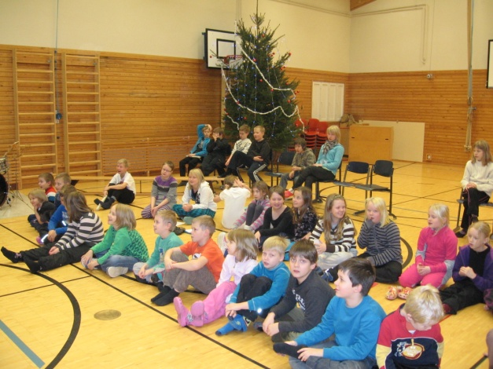
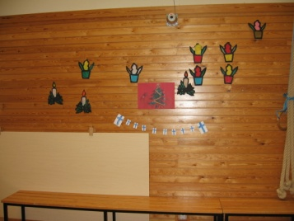
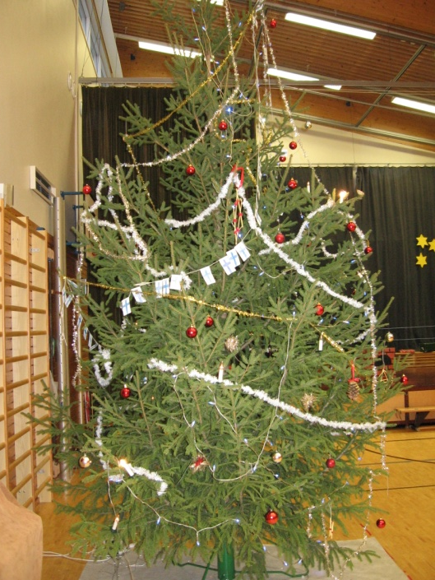
Christmas in Finland
At school we have a Christmas celebration at the end of fall term
We bring in a Christmas tree and we decorate our gym
Practising for the Christmas celebration

Slide 37
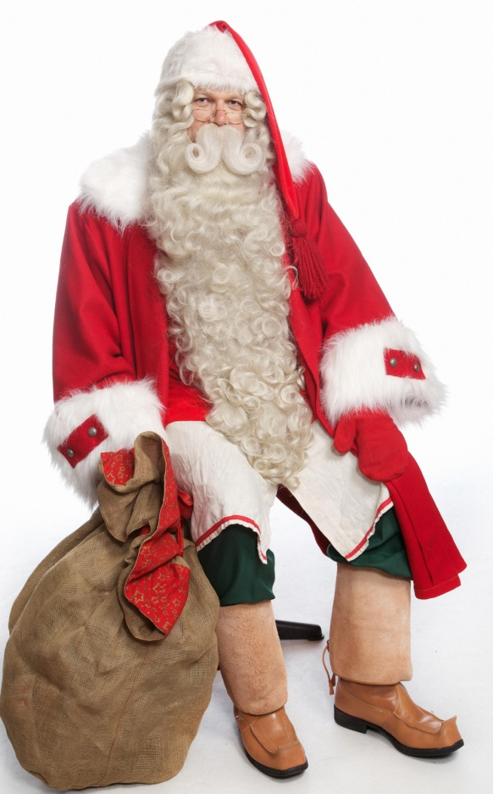
Christmas in Finland
In Finland Santa Claus brings presents to children on Christmas Eve.

Slide 38
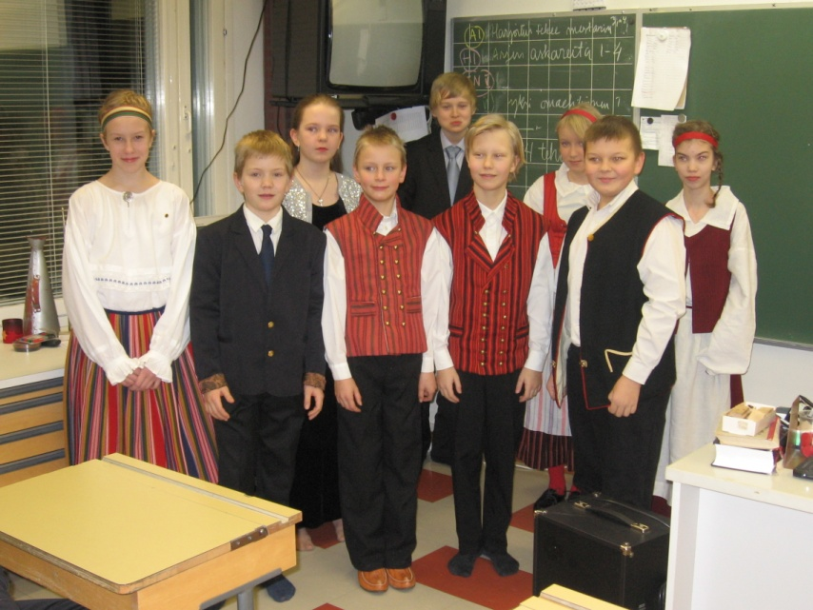
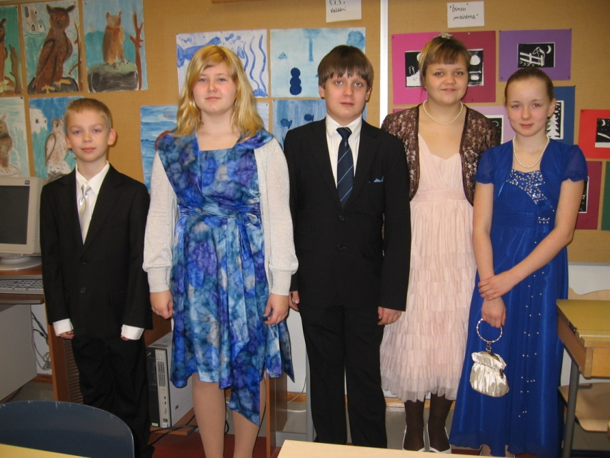
Christmas in Finland
On 6th December we celebrate our Independence Day. The 5th grade pupils are invited to the Town Hall.
Here are some pupils in traditional Finnish costumes and other fancy 5th graders.

Slide 39
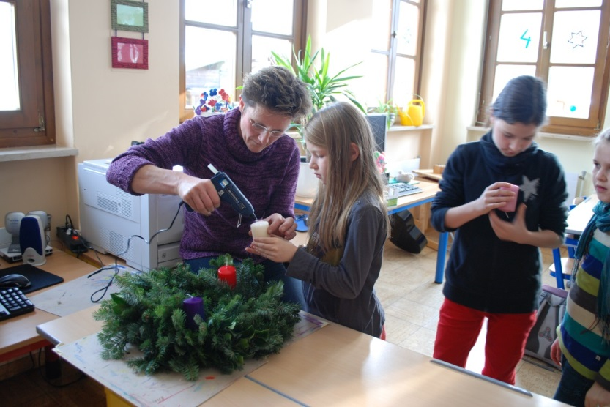
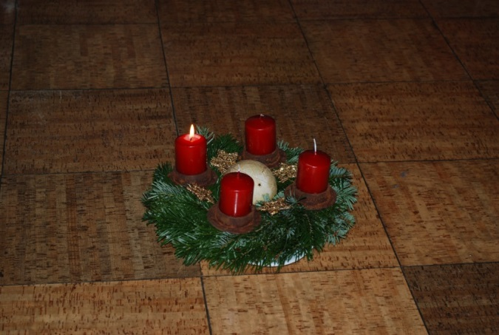
Christmas Customs in Austria
4 weeks before christmas nearly every family makes or buys an advent wreath. Each wreath has four candles, one for each Sunday in Advent. Every Sunday we light one more candle and we sing and eat Christmas cookies.

Slide 40
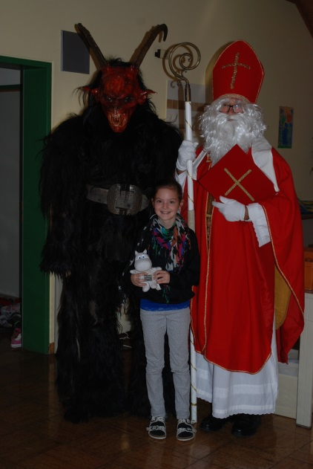
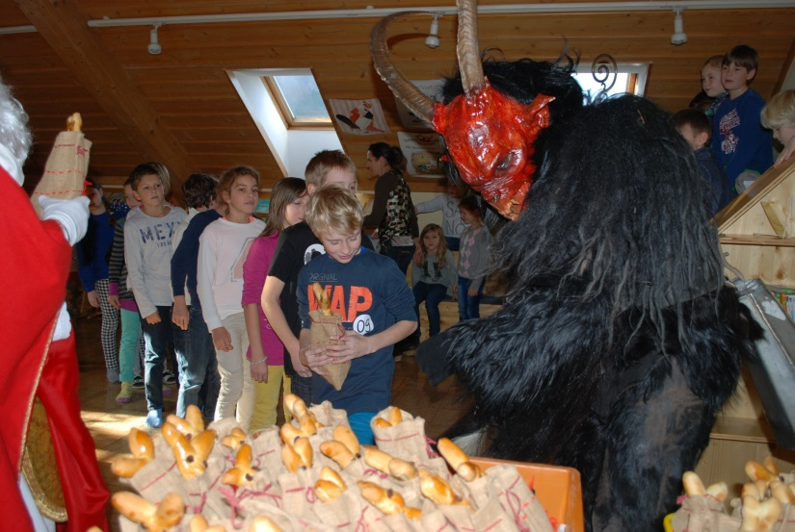
Christmas Customs in Austria
St. Nikolaus day is on 6th of December
St. Nikolaus is a nice, friendly person who gives sweets to the children. He goes from house to house and quite often he is accompanied by a Krampus!

Slide 41
Christmas Customs in Austria
24th December: The Holy Night
In the morning children are already very excited. They cannot wait until the evening comes.
Finally in the evening they hear a soft bell ringing, this must be the Christ Child. The family goes into the living room. There is a wonderfully decorated Christmas tree with lots of candles and under it, there are a lot of presents. Before the presents are opened they sing Christmas carols and read the holy story about Jesus’ Birth.

Slide 42
Christmas Customs in Austria
In Austria children believe that presents are brought from the Christ Child and angels help him.
On Christmas Eve often grandparents, uncles and aunts come for a visit. Families go to church at midnight.

Slide 43
Christmas Customs in Italy
Children hang up their stockings on the eve of the feast of the Epiphany waiting for the “Befana” sort of like a good witch who rides around on a broom bringing gifts to good girls and boys and coal, usually made of black sugar, to naughty ones.
“Buon Natale a tutti”! Merry Christmas to everyone!

Slide 44
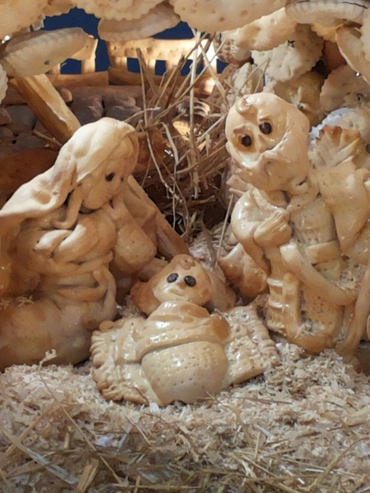
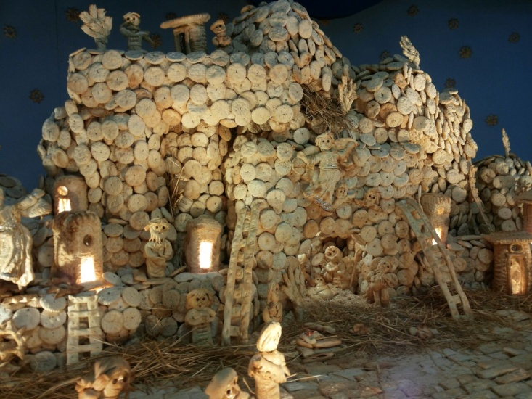
In Italy the Christmas season starts on 8th December for the feast of the Immaculate Conception and lasts until the feast of the Epiphany, 6th January. On this day Sicilians spend time with family having a good meal, putting up the Christmas tree and the Nativity Crib Scene and playing cards together. From this day onwards Christmas markets with various stalls with typical food, toys and crafts are often visited. During the following days decorations and huge Christmas trees can be found in main squares and a nativity season or “presepe” is usually put up in churches and town squares too. For many Italians it is the most important part of Christmas decorations.
There’s a very special tradition in Palermo. Each year bakers display a very original “presepe” made of bread. The figure of the Baby Jesus isn’t put into the crib until Christmas Eve.

Slide 45
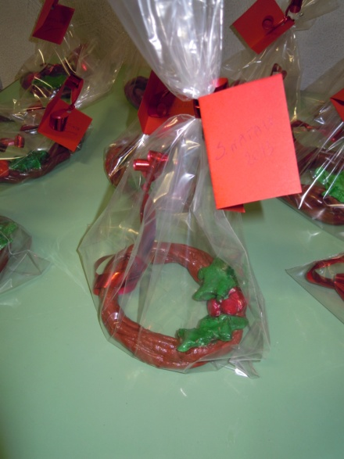
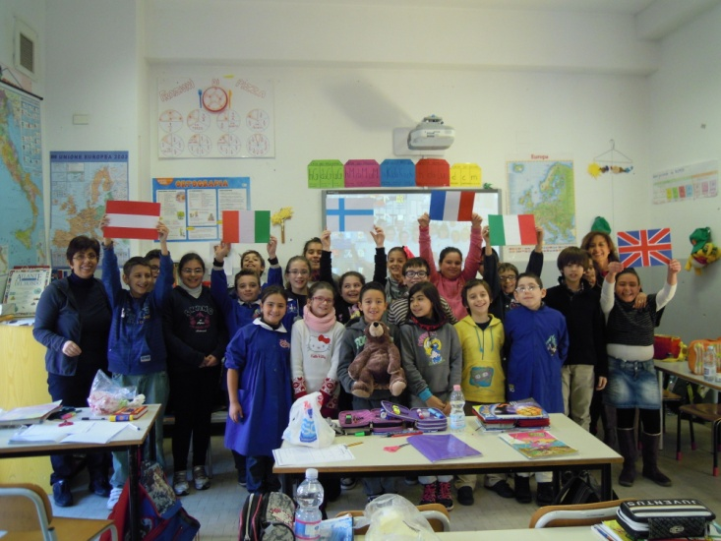
At school children learn Christmas carols and poems, make Christmas crafts and play bingo.
People spend Christmas day with family and friends, exchanging gifts and going to church. The traditional Christmas dinner, “Cenone” is made up of lasagne, different kinds of meat and fish and “panettone” or “buccellato”, typical Christmas desserts. Celebrations often extend into 26th December with the national holiday of “Santo Stefano”. Families get together and eat leftover Christmas dishes and sweets.

Slide 46
Children hang up their stockings on the eve of the feast of the Epiphany waiting for the “Befana” sort of like a good witch who rides around on a broomstick bringing gifts to good girls and boys and coal, usually made of black sugar, to naughty ones.
“Buon Natale a tutti”! Merry Christmas to everyone!

Slide 47
Christmas at Gamlingay First School
A highlight of the school Christmas season is when the youngest children in the school perform the Nativity.

Slide 48
Christmas at Gamlingay First School
We have a Christmas Market. We make things in school to sell to our parents and then we give the money we have raised to a charity. We also collect shoe boxes with presents inside them. The shoe boxes are then shipped off and given out to children who wouldn’t get presents at Christmas.

Slide 49
Christmas in an English classroom
In our classrooms we have lots of Christmas cheer. We decorate our classrooms with a tree, paper-chains, snowflakes and an advent calendar. We exchange cards, make hats, calendars and Christmas cards and we have a party!

Slide 50
Focus: Places of Interest
Each school chose a place of interest. Some children visited it, made an advertisement for it and made a model of it.

Slide 51
King’s College, Cambridge, England
We found out all about Cambridge, a city which is about 20 miles from Gamlingay. There are lots of places of interest in Cambridge, as our advertisements show. Cambridge has a very famous university. King’s College has a beautiful and very impressive chapel which was the place of interest we chose to look at.
People enjoy punting along the River Cam, which flows past King’s College Chapel.

Slide 52
A group of ten children aged from 4-9 visited King’s College Chapel.

Slide 53
The same group of children made a clay model of the chapel. They spent a long time making it.

Slide 54
Salzburg Dome, Austria

Slide 55
We visited Salzburg Dome.

Slide 56
We made our own models of Salzburg Dome

Slide 57
We made models of Clonakilty, Ireland

Slide 58
Places of Interest: Inchadoney Beach

Slide 59
Parish Church, Clonakilty

Slide 60
Clonakilty Streets

Slide 61
Château de Rambures
This castle was built for David of Rambures during the Hundred Years War between France and England.
It was the first castle in France designed to resist artillery: that’s why the round towers are made of bricks instead of stones.
With 70 soldiers and 16 canons, it was an almost impregnable fortress.
After over six hundred years, very few changes have been made and the fortress is still there!

Slide 62
Our guided tour

Slide 63
Our workshops
Writing with a goose quill and creating a coat of arms

Slide 64
Our model and our posters

Slide 65
Bastioni, Finland

Slide 66
The main entrance to the Bastion
Our guide told us of the history of our town. Here is our sports field surrounded by an embankment.

Slide 67
Hamina Bastion
This is a bird’s eye view of Hamina from 1809.
Hamina was built in a circular form.

Slide 68
We built a model of the Bastion

Slide 69
The Zisa Palace, Palermo, Italy

Slide 71
The castle of the Zisa was built during the Norman domination, in the ΧII century, in a typical architectural style of Arabic origin. It was finished in 1175 under the kingdom of William II. Norman kings used to spend their summer time in the castle and nearby gardens.
Some centuries later the palace became the residence of a Spanish family, the Sandovals, and then, after their death, it belonged to the Notarbartoloes.
Actually it is a public monument and lots of tourists usually visit it and its Museum of Islamic Art..

Slide 72
Here is our model

Slide 73
Ireland, March 2014
Our 2nd meeting was hosted by Knockskeagh National School,
At the meeting there were 3 English, one Finnish, 3 French, 2 Austrian, and 2 Italian representatives.

Slide 74
At Knockskeagh we received a warm and very musical Irish welcome. We had a tour of the local town, Clonakilty, enjoyed the beautiful Irish countryside and had a demonstration of how to bake Irish scones.

Slide 75
We also enjoyed learning a local craft – felting.

Slide 76
Focus: Dance
Each school chose a dance. They made an instruction DVD and children from at least one other country learnt the dance.

Slide 77
The Irish learnt the French dance

Slide 78
The Austrian children performed their own dance, and learnt all the dances, including the English dance.

Slide 79
The English children performed a traditional English dance and learnt a Finnish dance.

Slide 80
The French pupils performed their own dance and learnt an Irish dance.

Slide 81
A traditional Italian dance is the Tarantella

Slide 82
Dancing
The Finnish dance ”Lintu lensi oksalle”
The Picardian dance (from France)

Slide 83
Focus: Singing
Each school shared a traditional song from their own country as well as learning songs from other countries.
We all learnt Frères Jacques in other languages as well as our own.

Slide 84
Fra Martino Campanaro
Fra Martino Campanaro
Dormi tu Dormi tu
Suona le Campane, Suona le Campane
Din-Don-Dan, Din-Don-Da
Aindí Leisciúil
Aindí Leisciúil, Aindí Leisciúil,
I do luí, I do luí,
Tá sé in am bricfeásta, Tá sé in am bricfeásta,
Ding dang dong, Ding dang dong,
Jaakko kulta, Jaakko kulta!
Jaakko kulta, Jaakko kulta!
Herää jo! Herää jo! Kellojasi soita! Kellojasi soita! Pium paum poum, Pium paum poum!
Frere Jacque
Frere Jacque, Frere Jacque,
Dormez vous, dormez vous,
Sonnez les matines, sonnez les matines
Ding dang don, ding dang dong
Bruder Jacob
Bruder Jacob, Bruder Jakob
Schlafst du noch Schlafst du noch
Horst du nicht die glocken, Horst du nicht die glocken,
Ding dang dong, Ding dang Dong.
Are you Sleeping?
Are you sleeping? Are you sleeping?
Brother John, Brother John,
Morning bells are ringing, Morning bells are ringing
Ding dang dong, Ding dang Dong

Slide 85
Focus: Composers
Each school chose a composer from their own country. They learnt about that composer, listened to their music and then shared with the other countries.

Slide 86
Wolfgang Amadeus Mozart
He was born in January 1775 in Salzburg. Even as a child he was a famous musician. He composed a lot of music, that is still very popular. Among his most famous pieces are: The Little Night music and The Opera of the Magic Flute. He died in Vienna as a young man.

Slide 87
Jean Sibelius
He was born in 1865 in Hameenlinna, near Helskinki. His real name was Johan Christian Julius Sibelius and he had 6 daughters. He played the piano and the violin and studied music in Helsinki, Berlin and Vienna.
He gave concerts all over Europe and in the United States and he became a Finnish icon in both world wars.
His most famous works include Finlandia, Valse triste and Karelia.

Slide 88
Edward Elgar
Elgar was born on 2nd June 1857 in Worcester in the English West Midlands. His father had a music shop in Worcester and tuned pianos.
He taught himself to play many instruments in his father’s shop and began composing music when he was in his 20s.
His most famous work is known
as ‘Nimrod’, from the Enigma
Variations.

Slide 89
Bill Whelan is a contemporary Irish Composer who was born in 1958.
His most famous work is Riverdance which was the interval act at the 1994 Eurovision.
Bill Whelan uses traditional Irish rhythms, language, harmonies, instruments and dance in his music. Riverdance made Irish music famous across the world.
The feet dancing acted like percussion during the music. Michael Flatley was the lead dancer. He holds the world record for tap dancing. He can tap 35 taps per second!

Slide 90
Camille Saint-Saëns is a French composer from the romantic period. He composed his first piece at the age of 3. He was conductor, critic, music scholar, teacher and composer. His best-known works are several concertos, an organ symphony and The Carnival of the Animals."

Slide 91
Antonio Vivaldi was born in Venice in 1678 and died in Wien in 1741. He was an excellent Italian musician and composer in the Baroque period.
When he was a young boy, he suffered from asthma and could not play outside with the other children. He was taught to play violin by his father, and became a very good violinist very early.
When he grew up, he became a priest. He had red hair, so everyone called him "The Red Priest".
Unfortunately, because of his asthma, Antonio could not continue to lead a normal life as a priest. So, he worked a lot on writing beautiful music, especially music for his instrument, the violin.
He became the head of the Conservatory of the Ospedale della Pietà, which was an orphanage for over 6.000 girls. These girls were given a good education at the orphanage. One of the most important subjects at their school was music. Vivaldi wrote over 400 concertos for his students and people came from all around to hear them play. During his life, he also travelled across Europe and his music was very appreciated in Prague, Amsterdam and Wien.
He is still a well-known musician all over the world, and a collection of four concerts, called "The four Seasons", a very good example of descriptive music, is the most famous of his compositions.
Antonio Vivaldi

Slide 92
Focus: Outdoor Games
Each school shared an outdoor game their children particularly enjoyed. They then sent instructions to all the partner schools so that they could learn to play the games from each other’s country too.

Slide 93
Here the Austrian children are learning to playing Hop Skotch from Italy.

Slide 94
Austrian Games
The Austrians played all the games. Local TV reported on it.The children liked the Finnish and English games very much.
The Italian Game

Slide 95
English games
English children love playing kick rounders and shared the rules of the game with the other countries.
They enjoyed learning a game that children in Austria play.

Slide 96
An Outdoor Italian game: La campana

Slide 97
Italian children loved playing the Irish game, Gaelic football.

Slide 98
Playing games
English: ”kickrounders”
Finnish: ”purkkis”

Slide 99
The French children played a traditional French game and a Finnish game.
We learnt a Finnish game.

Slide 100
In Ireland children played their traditional games of Gaelic Football and Hurling
Here they are learning the Austrian game.

Slide 101
Focus: Gardening
Each school planted, and grew fruit and vegetables to encourage the children to take an interest and enjoy being outdoors… and then they waited patiently for the fruits of their labours!

Slide 102
In Ireland, we grew peas, lettuce, strawberries, beetroot, pumpkins and apples this year!
We have a hotel for bugs in our school garden!

Slide 103
In an English country garden…!
We have a gardening club that takes place at lunchtime each week.
As well as growing vegetables,
we plant bulbs and flowers, pull
out weeds and keep our school
grounds looking lovely!

Slide 104
French children prepared some seedlings for the school garden.

Slide 105
Gardening for Easter

Slide 106
Austrian garden
Gardening in Austria: we are sorry we have no real garden, so we had to plant in little pots. But it was fun to see things grow. 1st class planted sunflowers for Mother‘s Day! 2nd class planted seeds for herbs and so they had a wonderful snack for their break.

Slide 107
Gardening in Italy. In the month of November it is Tree Day and each class writes poems, makes posters and plants trees.

Slide 108
France, June 2014
Our third meeting was hosted by Ecole Primarie d’Oust-Marest
At the meeting there were 2 English, 2 Finnish, 2 Austrian, 2 Irish, and 2 Italian representatives.

Slide 109
We received a royal welcome at Oust-Marest. The children performed dances, learnt about composers and we played outdoor games together.

Slide 110
We also did some gardening together

Slide 111
Focus: Literature
Each school found out about a local legend and made it into a booklet to share with the other schools.

Slide 112
A legend says that some devils, painted in the palace, are the custodians of a wonderful treasure…
Do you want to find it?
Count the devils, if you can!

Slide 113
An Irish legend: Tir na nog

Slide 114
Austrian Legends
2 different local legends were drawn and written like a book by our pupils: The Stierwascher and The Devil‘s Bridge
The legends from the other countries were read,
and the French one was performed like a theatre by 4th class.
They organised everything on their own.

Slide 115
A Finnish legend: Kalevala

Slide 116
An English legend: Robin Hood

Slide 117
A French legend: Les Deux Bossus

Slide 118
Italy, October 2014
Our 4th meeting was hosted by ICS Lombardo Radice, Sicily, Italy.
At the meeting there were 3 English, 2 Finnish, 3 French, 2 Austrian, and 2 Irish representatives.

Slide 119
At ICS Lombardo Radice we received a very warm welcome in both the elementary and middle schools. We also enjoyed sight seeing in Sicily, some fantastic Sicilian cuisine and Sicilian Autumnal weather!

Slide 120
We met the mayor of Sicily!
We visited the Palace of Zisa, setting of their local legend!

Slide 121
Focus: Crafts
Each school shared some of their crafts with the other schools and then used those ideas to do crafts in their own schools.

Slide 122
Knockskeagh National School, Clonakilty, Ireland

Slide 123
Austrian Handicraft
It was great fun to do all the handicrafts. Some very nice products were created.

Slide 124
Every week we have 2 lessons to work with our hands. We found out that there are similarities in handicrafts between all the countries.

Slide 125
We also worked on paintings and drawings. Some very creative works came out.

Slide 126
Finnish crafts
We made towels, winter scenery, owls, Halloween pumpkins and horses in our crafts lessons.
Masks from Austrian crafts

Slide 127
Gamlingay First School Crafts

Slide 128
Crafts that France shared

Slide 129
I.C.S ‘Lombardo Radice’ Italy
Crafts

Slide 130
Focus: Drawing
Each school drew pictures of activities that we can do in our leisure time. The pictures were then collated into a calendar for each school.

Slide 131
Knockskeagh National School, Clonakilty, Ireland

Slide 132
Volksschule Scheffau, Austria

Slide 133
Pyhältö school, Finland

Slide 134
Gamlingay First School, England

Slide 135
Ecole Primaire d’Oust – Marest

Slide 136
I.C.S ‘Lombardo Radice’ Italy

Slide 137
Focus: Cooking
Each school shared their favourite Christmas recipe with the other schools. The children then made some of the recipes from the partner schools.

Slide 138
Christmas cookies that France baked

Slide 139
Irish Cookery
Irish Christmas Decorations

Slide 140
Biscuit Santa

Slide 141
Austrian Cookies

Slide 142
Finnish Cookies

Slide 143
Italian Dessert

Slide 144
English Mince Pies

Slide 145
French Cookies

Slide 146
Austrian Biscuits
It was great fun to bake all the different Christmas biscuits in school and to try them.
“The best ones were the Finnish“ said the Austrian pupils

Slide 147
Christmas baking, Austrian Vanillekipferl

Slide 148
Gamlingay First School, England
The English children enjoyed trying out some of the recipes
sent to us by our partner schools.

Slide 149
I.C.S ‘Lombardo Radice’ Italy

Slide 150
Focus: Indoor Games
Each school had a focus on board games and shared favourite paper games with our partner schools. Through video conferencing the children then played the games together.

Slide 151
Knockskeagh National School, Clonakilty, Ireland
We made a game for our town.

Slide 152
We had 2 wonderful days in school playing board games.
We did it on Shrove Tuesday and when the French pupils came to visit us in Austria.
Everybody found a way to communicate. It was great fun!!

Slide 154
Pyhältö school, Finland

Slide 155
Gamlingay First School, England
Our parent support organisation bought a new board game for each class. We also had a board games club at lunch time for children to come to.

Slide 156
French games

Slide 157
I.C.S ‘Lombardo Radice’ Italy

Slide 158
Finland, March 2015
Our 5th meeting was hosted by Pyhältö, Hamina, Finland.
At the meeting there were 3 English, 2 Italians, 3 French, 2 Austrian, and 2 Irish representatives.

Slide 159
We were welcomed to Finland through traditional dance and singing. We played some Comenius games outside. As well as visiting Pyhältö we visited a bigger school in the town centre.

Slide 160
In our leisure time we went to a summer house for a sauna, a quick dip in the lake and to cook some sausages over a fire! We also enjoyed a cultural tour of Hamina.

Slide 161
Austria, April 2015
34 pupils from Oust-Marest, France visited Scheffau, Austria from 13th -17th April. They played outdoor games, participated in school activities and visited the local places of interest. The children from both countries were delighted to meet each other. Together, they had a wonderful week and developed their European identity.

Slide 162
They danced, sang, found similarities and differences in their culture, shared food, talked in different languages and made friends!

Slide 164
England, May 2015
Our final meeting was hosted by Gamlingay First School, England.
At the meeting there were 2 Italians, 3 French, 2 Austrian (and 6 Austrian children), 2 Finnish and 3 Irish representatives.

Slide 167
Digital Book
A digital book has been created to share some cultural information from the different countries, among the schools.

Slide 168
http://oust-marest.ee.ac-amiens.fr/didapage/

Slide 169
Surveys Summer 2015
Each school carried out a questionnaire to find out if the Comenius project had changed how children spend their leisure time.

Slide 170
Have you spent less time in front of a screen/ chosen valuable (different) leisure activities as a result of the Comenius project?
Answers in % | Yes % | No %
Austria | 89 | 11
England | 74 | 26
Ireland | 84 | 16
Italy | 75 | 25
Finland | 56 | 44
France | 74 | 26

Slide 171
Did you try a new activity with your family as a result of the Comenius project?
 | Yes % | No %
Austria | 52 | 48
England | 52 | 48
Ireland | 77 | 23
Italy | 75 | 25
Finland | 37 | 63
France | 87 | 13

Slide 172
Languages
Each school shared some basic vocabulary from their language with the other schools. This was recorded and put together as a video dictionary. The dictionary was then shared with children from the other schools.

Slide 174
The travelling bears at the final meeting.

